Slide 1
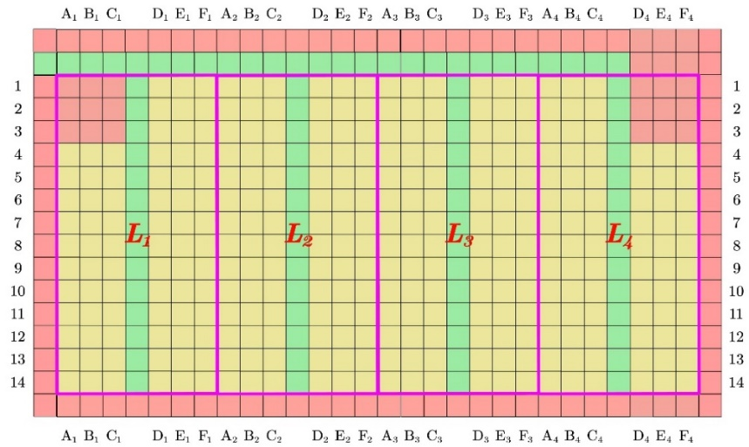
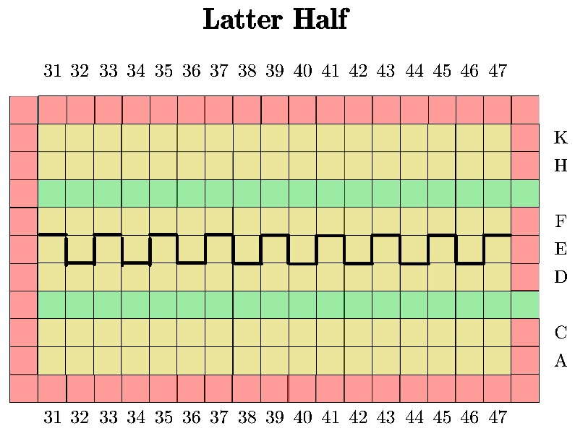
Block division
Two block division schemes
1

Slide 2
Block division
We divide the multi-aisle aircrafts into several blocks according to aisles
Can unify the models as each block is similar to one-aisle aircraft
Is plausible because there would be no inter-aisle disruption
Our work reduced to finding the best in-block and between-block strategies
Only to find the between-block sequence as we can use the previously shown in-group sequence (similar to one-aisle aircraft strategy)

